Slide 1
Stock Tracker
Nicholas DiMaria

Slide 2
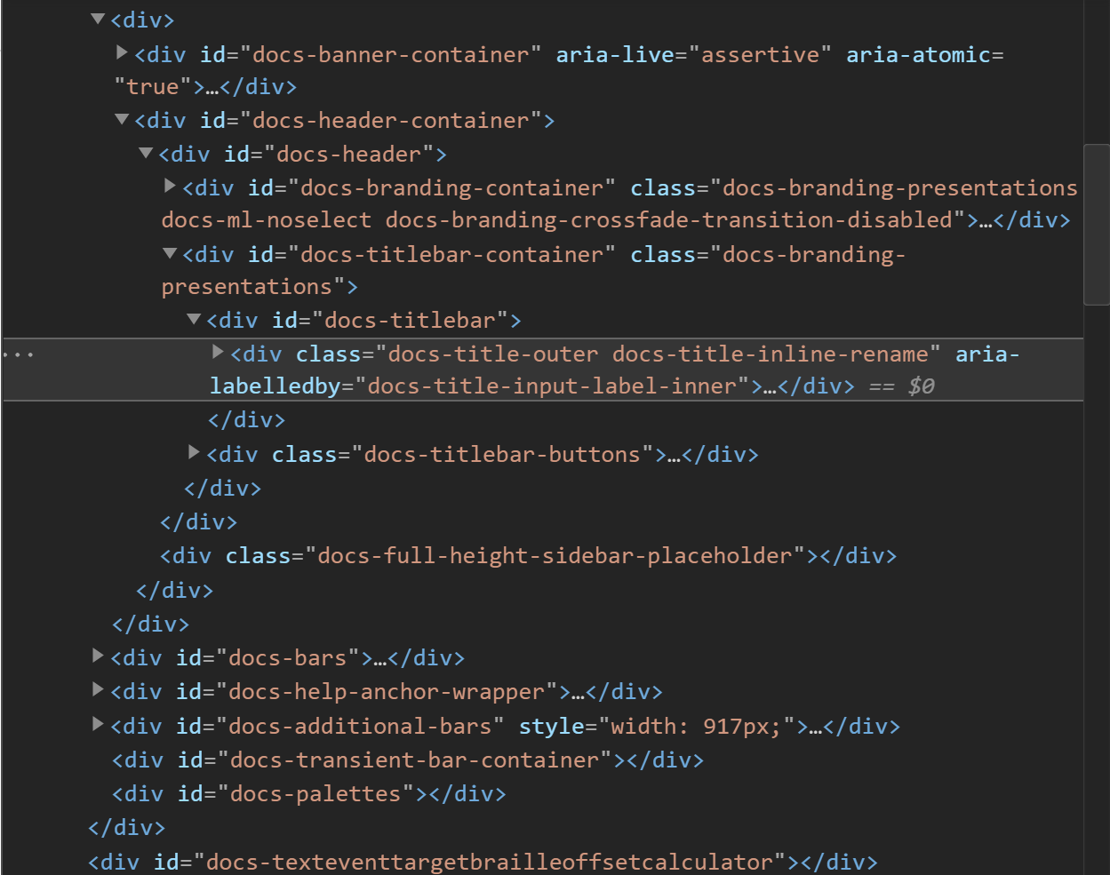
Web Scraping with lxml
Every element on website has a path
Using paths can grab specific elements
Can grab all of one element using classes
Very simple for single elements
Harder for tables

Slide 3
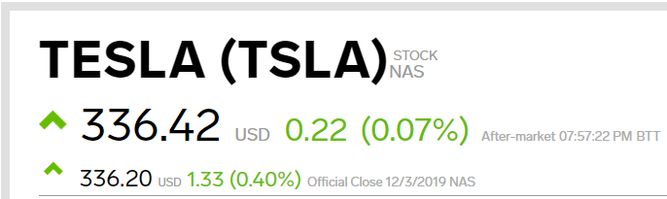
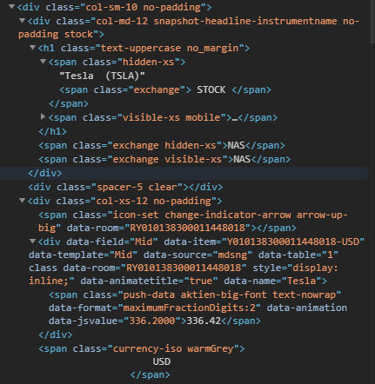
Stock Data Scraped
For each stock
Name
Stock Ticker
Up or down
Price
Price Change
Example path
/html/body/div[2]/div[6]/div[2]/div/div[2]/div[3]/div/div[1]/div[1]/div[1]/h1/span[1]/text()

Slide 4
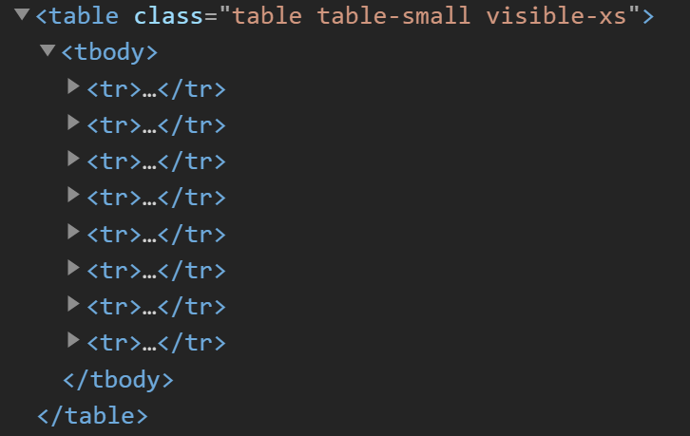
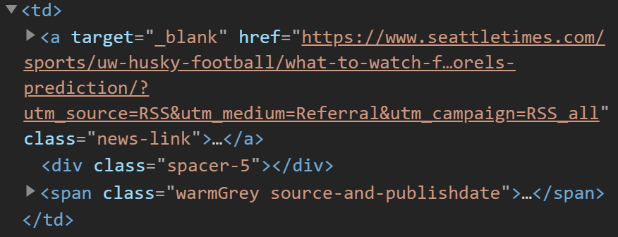
Table formatting with pandas
Each row of a table contains the same data
Grab data from each row and store in a column
Example:
href (URL)
News Article Title
News Article Website

Slide 5
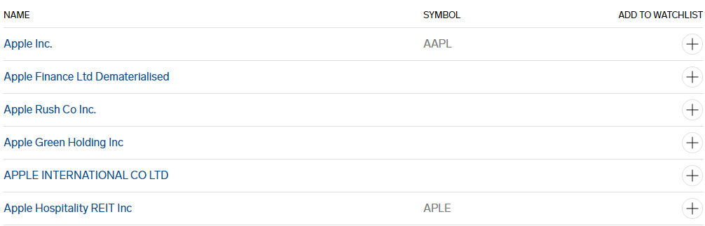
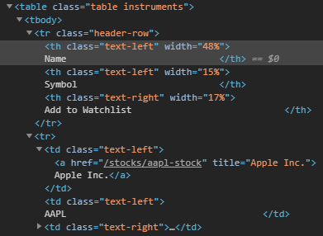
Tables Scraped
Result of a search
Only displayed ones with tickers
Name
Symbol
News
Title
Link
Website name
Headers used as names of columns
Store all data in correct columns

Slide 6
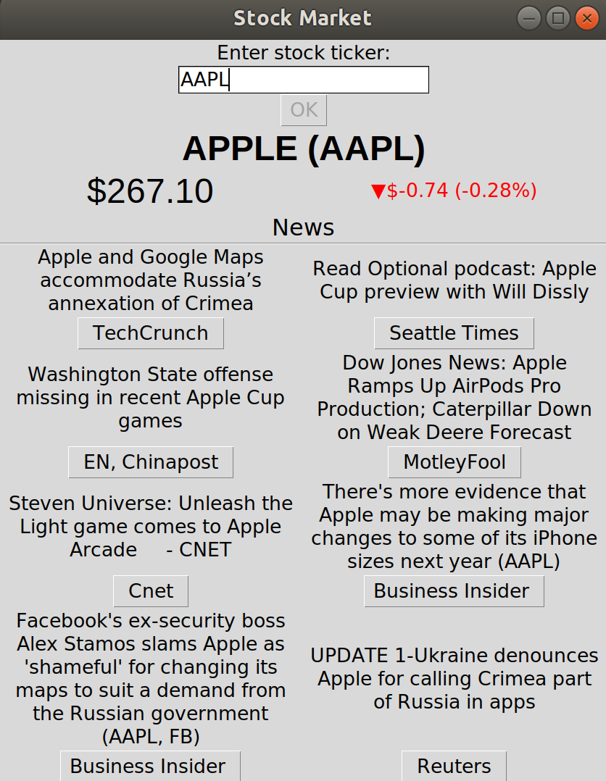
GUI with tkinter
Many different basic GUI options
Button
Entry box
Listbox
Simple formatting
Font
Colors
Grid functionality
Allows for nice layouts

Slide 7
Difficulties
Web Scraping
Understanding HTML
Getting the right data
GUI
Everything where I want it
Logical flow/ buttons
Effective way to display data

Slide 8

Demo

